Slide 1
Data Analytics and Visualization Approach Application to Service Division Dashboard
By Shafquat Arefeen

Slide 2
Introduction
Overview of Data Analytics and Visualization
Importance of data-driven decision making
Role of visualization in understanding complex data
Understanding the scope:
Who will be looking at the dashboard?
How can it inform their decision making?
What are the KPIs?
How frequent is the data refreshed?

Slide 3
My Approach to Data Analytics
Define Objectives
Identify key metrics to track
Understand who the target audience is and what are the questions they’re trying to answer
Data Collection
Gather data from various sources
Ensure data is formatted correctly and has a method to be updated regularly
Data Processing and Transformation
Use tools like Python and Apache Airflow to schedule jobs that clean and transform the data
Use GitHub to track version history and work with multiple data users
Visualization
Create interactive dashboards using Tableau that answer the questions and keep users coming back

Slide 4
Application of My Approach
Purpose: Monitor Service Requests (SRs) across divsions
Key stakeholders:
311
Divisions
Councillors (Wards)
Key Performance Indicators (KPIs)
Frequency of requests
Turnaround Time
Estimated Cost
How can we address all the stakeholder’s needs and provide a fair comparison between different requests?

Slide 5
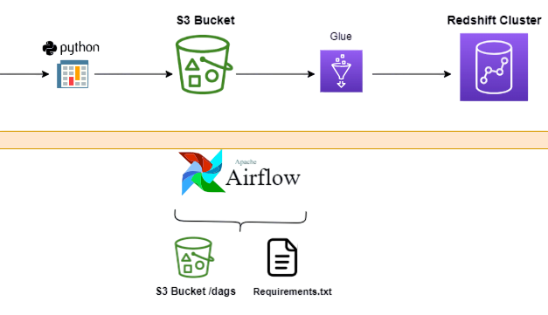


Data Pipeline Automation
Currently the data comes in as a file. The DAG would need to be adjusted if we switched to a different source like an API
Airflow automates data ingestion and transformation irrespective of where the source data is coming from

Slide 6
Tools and Techniques Justification
GitHub
Track version history
Work with multiple data users (branching and pull requests)
Python for Scripting
Versatile and widely used for data manipulation
Open-source libraries that allow for future-proofing work
Apache Airflow for Automation
Robust orchestration tool for scheduling and monitoring workflows
Amazon S3 for Cloud Storage
Scalable and cost-effective cloud storage solution
Amazon Redshift allows users to analyze data efficiently
Tableau for Visualization
Powerful tool for creating interactive, always-on (live) dashboards

Slide 7
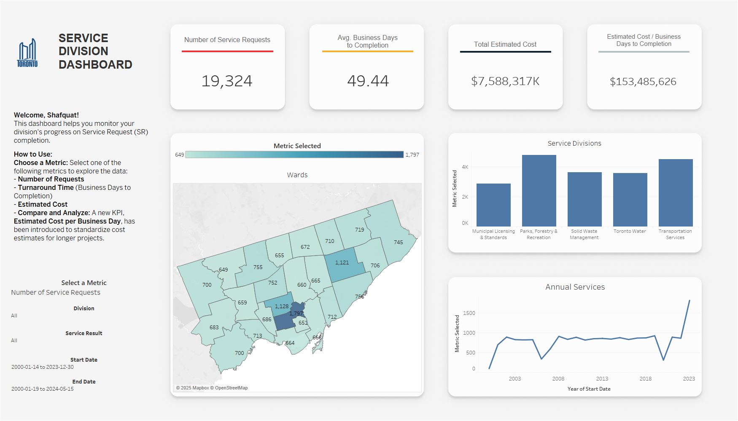
Key Metrics Visualized

Slide 8
Insights and Results
PFR has the highest turnaround time (~70 business days) – 75% more than other divisions
2006 and 2020 had a significant decrease in service requests
2020 is probably due to lockdowns. 2006 is worth looking into
Estimated Costs have skyrocketed in the last couple of years
~90M prior to 2021 -> ~4B in 2023
Mainly due to MLS, PFR, and TS across all wards
Scarborough Centre has a relatively high cost per business day
This means that the costs were high given the amount of time it took to finish services in this Ward.
This is relative to the rest of the city.

Slide 9
Take-aways
Challenges Faced
Managing AWS costs associated with the pipeline
Ensuring data accuracy and consistency
Division names were misspelled
Future Enhancements
Implement real-time streaming from APIs instead of from csv files
Optimize pipeline for cost efficiency

Slide 10
Conclusion
Effective data analytics and visualization can drive improvements to Service Requests
Continuous enhancement of tools and processes is essential
Having a live view of the dashboard for any user is vital to the longetivity of the dashboard
Questions?

